Slide 1


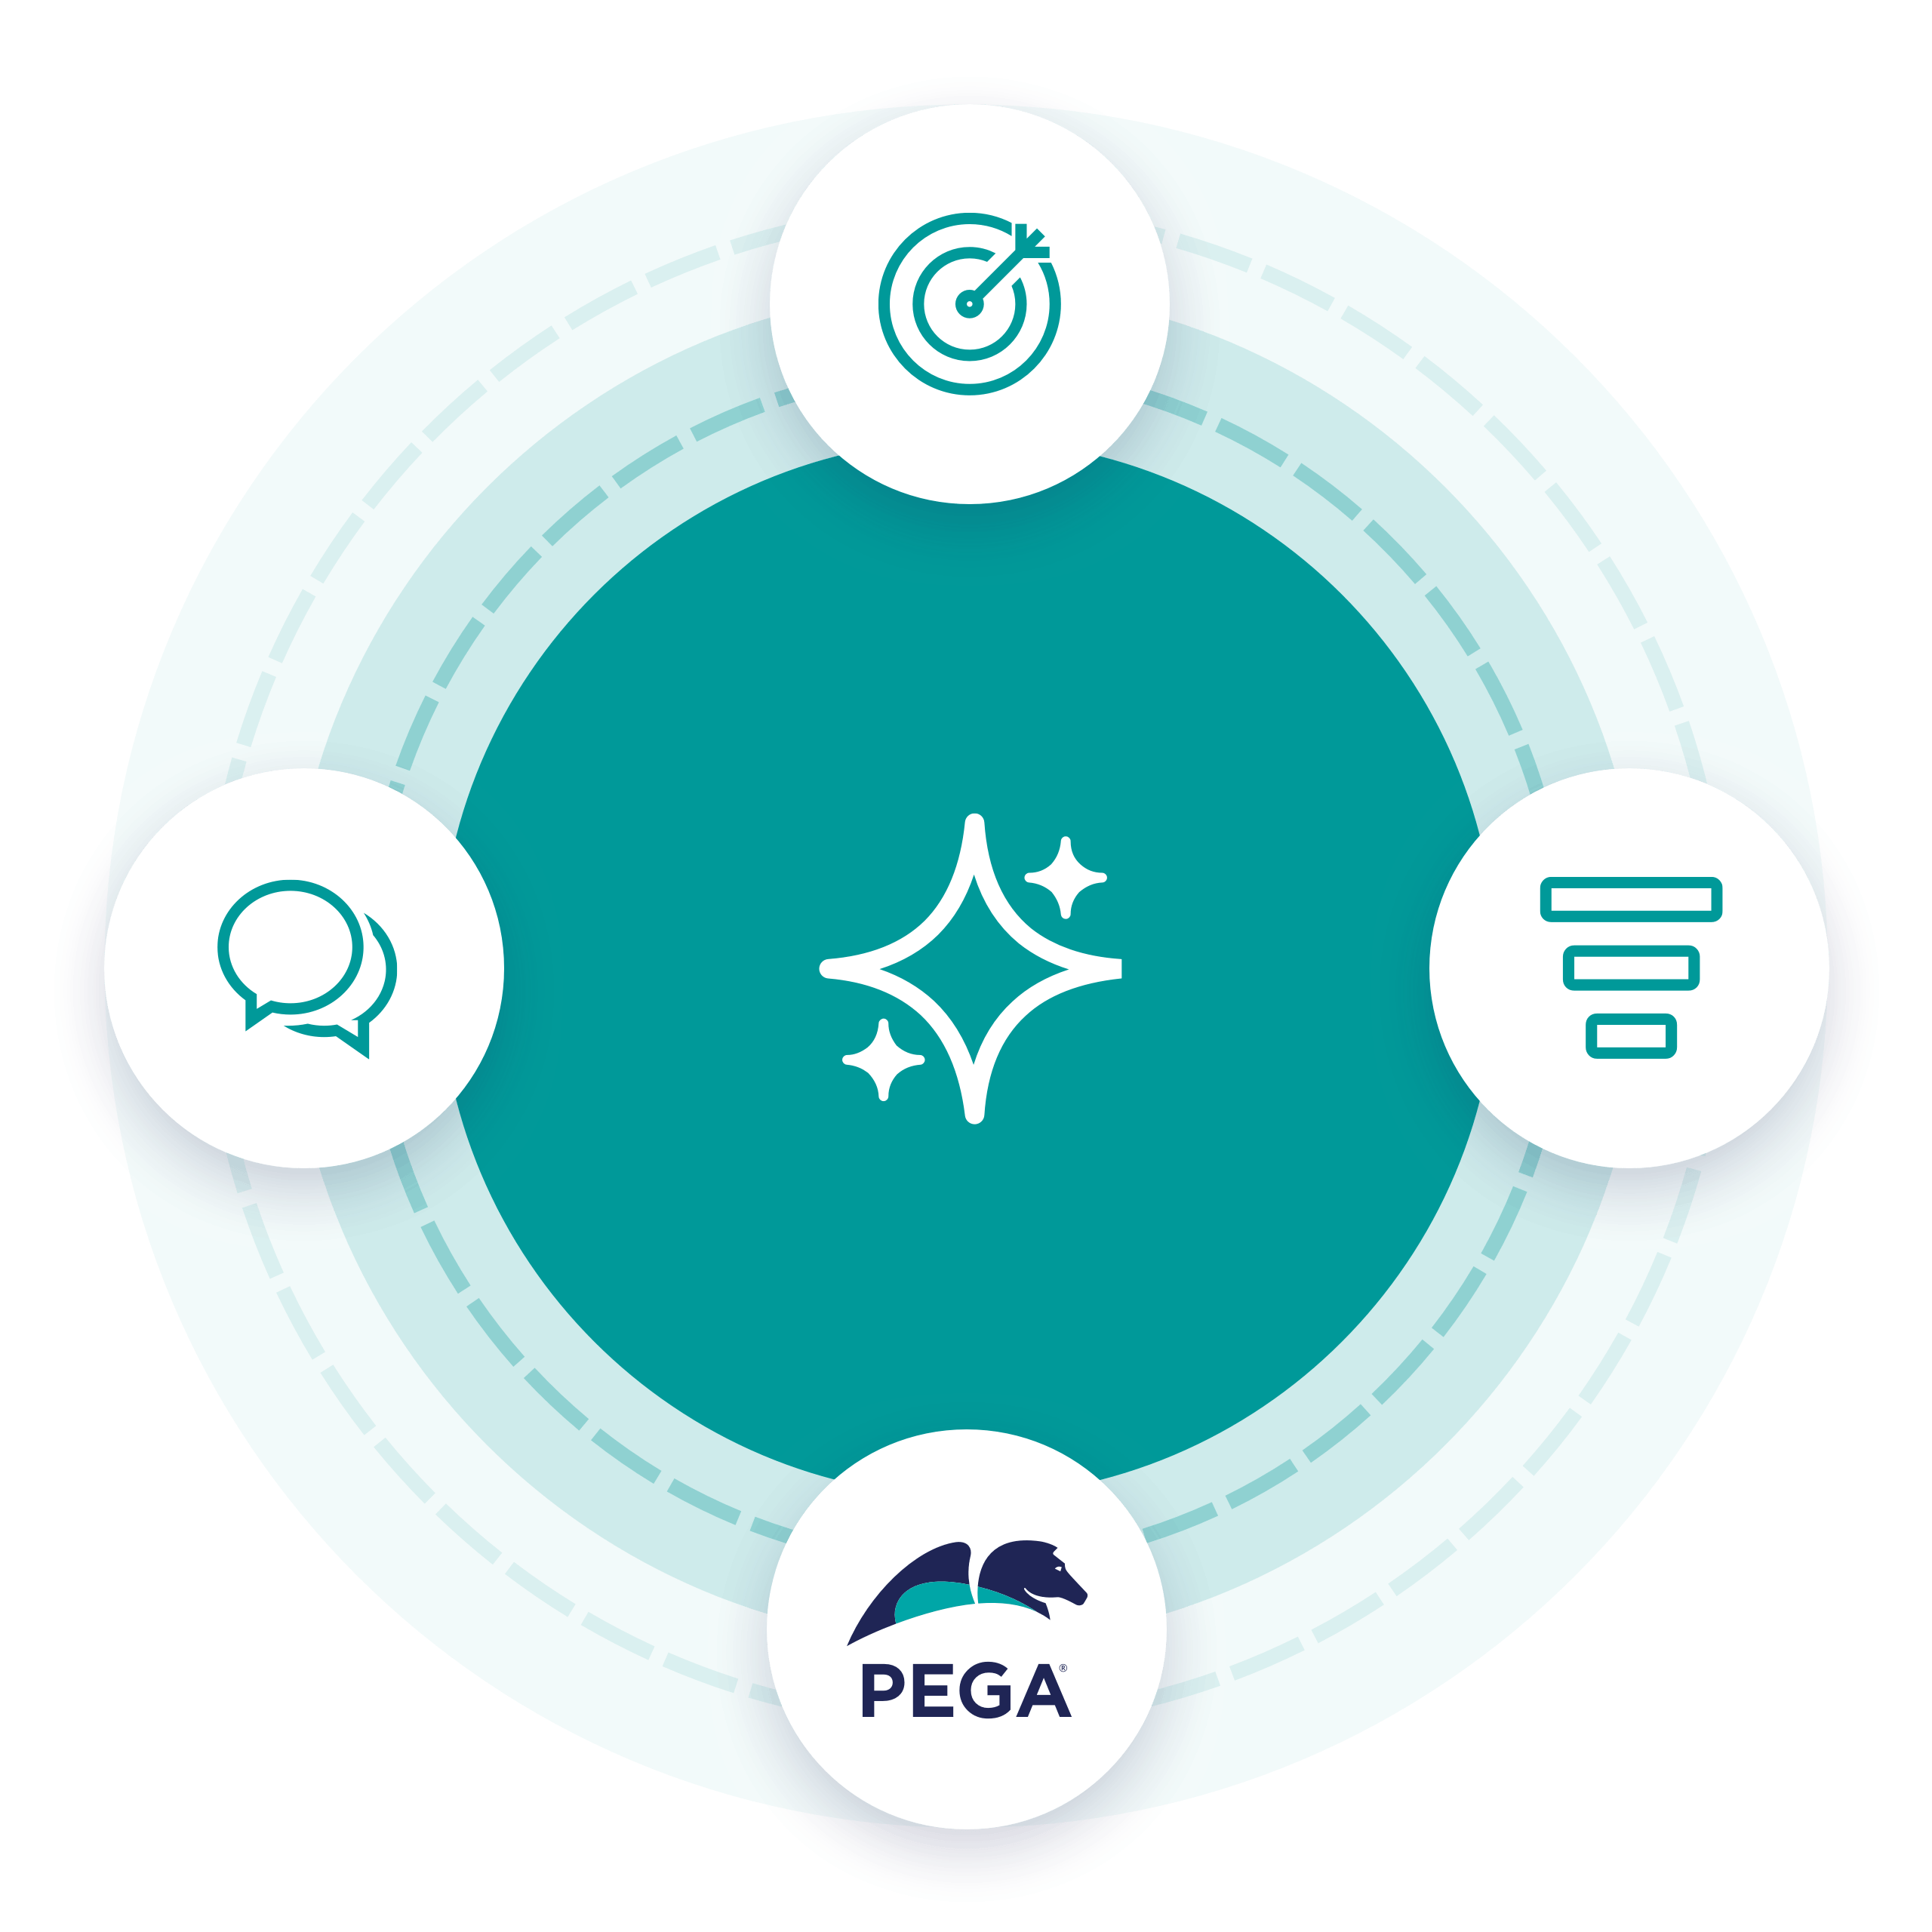

Safe hands patient engagement platform Reduce no Show appointments | collaboration
Powered by Pega AI

Slide 2
Problem statement
Importance of patient engagement platform
In todays world, patients are far too occupied to have time to wait around for the services that they don’t need. There are significant number of patients who would no-show for their scheduled visits or do not respond to the automated telephone call to cancel their appointments. Based on a recent study, one out of every five patients who schedule an appointment don’t show up. Every time a person skips their appointment, the healthcare industry endures a financial loss and patients miss out on receiving the treatment they need.
In just a matter of four months as the COVID-19 pandemic spread across the world, it has stretched healthcare infrastructure of even the most developed countries. The rapidly increasing demand on health facilities and health care workers threatens to leave some health systems overstretched and unable to operate effectively.

Slide 3
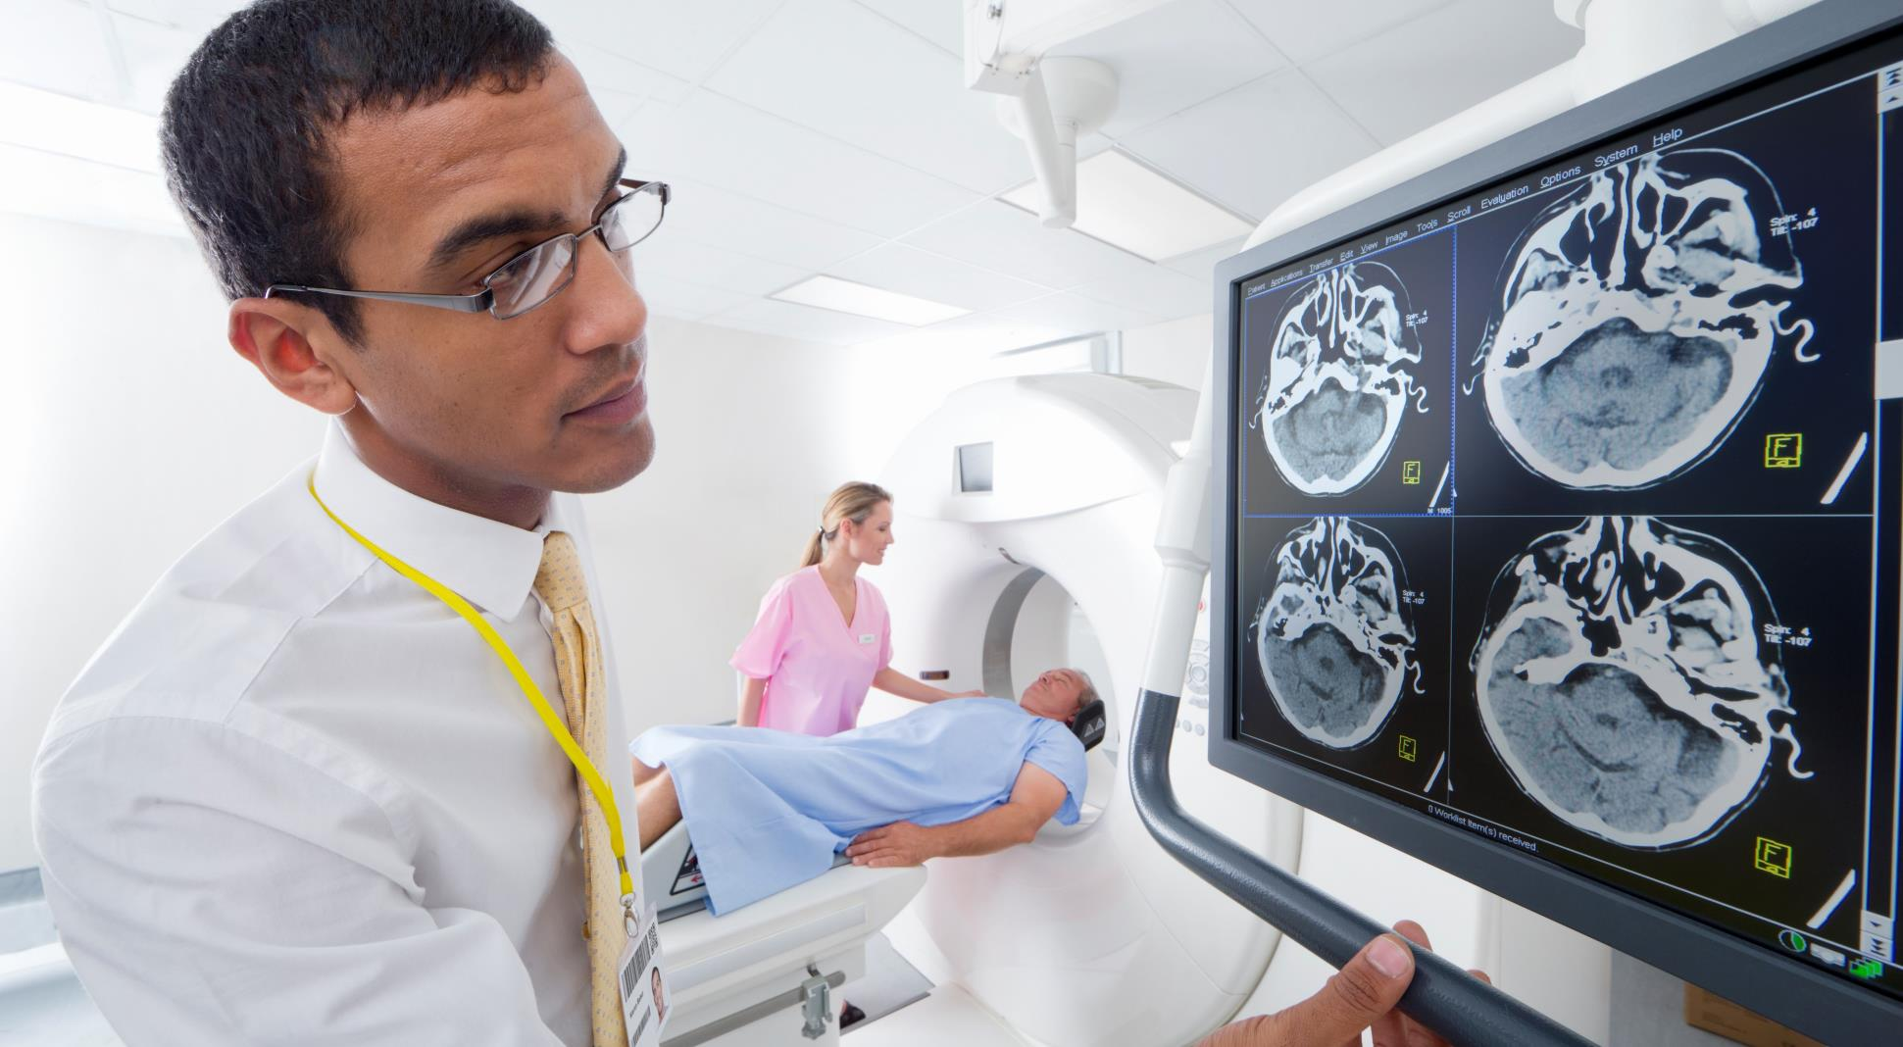





Real-world impacts of NO Show appointments
62/Day*
$3m*
$150B*
$125 - $350*
$38%*
Average missed appointments in a community hospital
Costing a community hospital due to No-Show
Losses Due to No-Shows in US Healthcare
Each no-show costs a physician
Forgot/did not know about scheduled appointments
Wastes valuable time/ Revenue

Slide 4


Appointment MODELs
Clinical Trial Schedules
Primary Care Appointments
Virtual Healthcare Appointments
Clinical trials are research studies performed in people that are aimed at evaluating a medical, surgical, or behavioral intervention. They are the primary way that researchers find out if a new treatment, like a new drug or diet or medical device (for example, a pacemaker) is safe and effective in people.
Schedule of Procedures will be preloaded as per the Study plan given by the sponsor.
Primary care appointments are staffed by physicians, nurse practitioners, and nurses experienced in the medical needs of college students.
To meet the needs in a timely and meaningful way, and to be available to you, please show up 15 minutes prior to the appointment time.
If the patient show up more than 5 minutes late, they will be asked to reschedule the appointment, and will be charged a $25.00 no show fee.
Virtual healthcare refers to the “virtual visits” that take place between patients and clinicians via communications technology — the video and audio connectivity that allows “virtual” meetings to occur in real time, from virtually any location.
A virtual visit can be a videoconference between a doctor and a patient at home. It could mean that a patient can interact with an offsite medical specialist via a high-definition conference hookup at his or her local clinic, instead of traveling to another city..

Slide 5



Actors Involved
Connecting patients, doctors, and staff on one single platform.
Patient
Health Care Assistant
Doctor
Schedule appointments through Safe Hands mobile app or web based platform.
Post queries at anytime from anywhere using a collaboration platform.
Gets personalized daily reminders of prescribed medicines based on the special instruction through our automated reminder framework.
Gets access to the documents, health videos etc shared by the health care representative.
Can change the notification preference at any time based on the choice.
Initiates patient registration flow which onboards the patients into Safe Hands platform.
Helps in resolving the question of the patients using collaboration platform.
Create private patient groups for private conversations between doctors and patients.
Get access to all the No-Show appointment dashboard charts.
Helps patient engagement by sharing the health tips in the form of documents to patient groups.
Has a dedicated portal to access all the consultation requests.
Can easily capture the symptoms and prescribe medicines from the application.
Can also cancel the consultation if the patient has not attended the appointment requests.
Also has an option to virtually assist patients through integrated video calling platform.
Can help the patient in resolving their health related questions through collaboration platform.

Slide 6

OUR BIG IDEA
In order to reduce the repercussions of patient no-shows, we have implemented a new patient engagement platform built on Pega Infinity. This solution helps to predict no-show appointments for clinical trials, primary care and even specialty medical appointments powered by Pega self learning adaptive AI models.
This platform also helps to reduce physical interactions complemented with digital contactless collaboration and personalize all patient communications based on individuals' health conditions, medications with auto reminders.

Slide 7
Key features of our patient engagement solution
Predict No-Show Appointments
Contactless Virtual Appointments
Automated Personalized Reminders
AI is becoming a critical component for every industry. We have leveraged Pega Self-learning adaptive models that can suggest No-Show propensity by taking decisions in real-time. We have defined set of predictors based on data sets and designed an interactive mobile app to feed the data to train our models.
Virtual consultation through skype that take place between patients and doctors via communications technology — the video and audio connectivity that allows “virtual” meetings to occur in real time, from virtually any location.
Designed a framework on top of Pega Notification Framework to send daily Prescription reminders and appointment notifications to accomplish critical health tasks. These reminders are typically sent to individual patients to independently perform health tasks
Patient Centric SafeHands Mobile App
Instant Collaboration Platform
Data Sharing
This feature facilitates collaboration and conversation among patients, doctors and health care assistants. We have leveraged the out of the box Pega Pulse and Spaces to create patient groups to enable patients to post health related questions.
Data sharing is an option to send videos, files between hospital and their patient. Patient data may include information relating to their past and current health or illness, their treatment history, lifestyle choices and diet details. We have leveraged the Pega out of the box documents gadget to build a better alternative to emails as the data might contain PHI.
Now a days, Mobile apps become a primary way through which people patients contact hospitals. We have leveraged Pega Low Code mobile app builder to develop this Pega Mobile app.

Slide 8
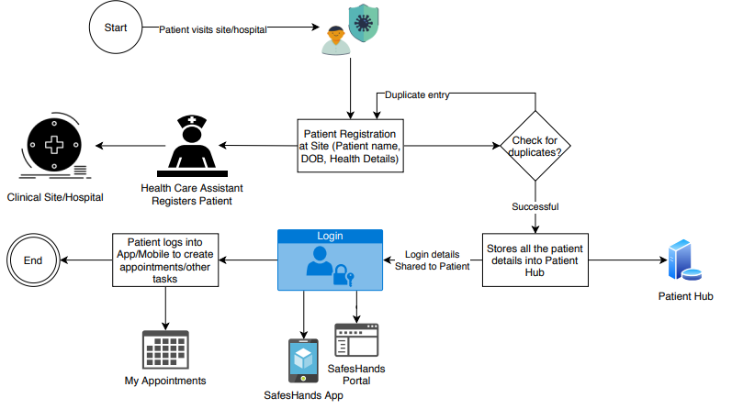
Patient Registration

Slide 9
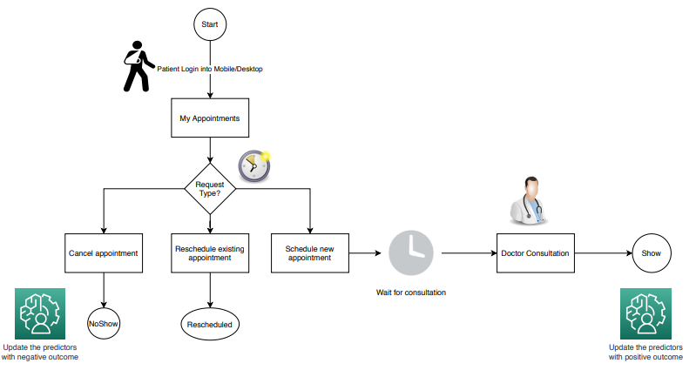
Appointment booking

Slide 10
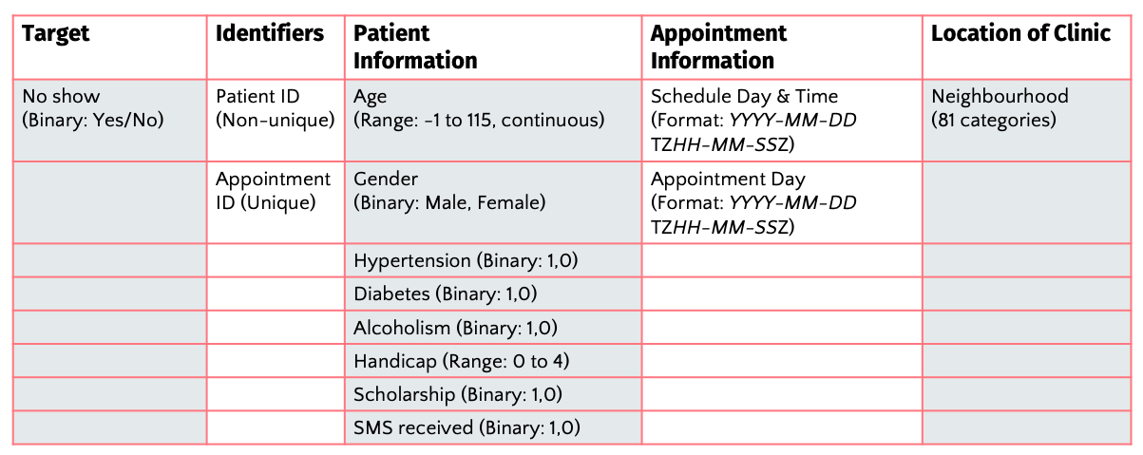
Identified predictors : based on a Kaggle dataset comprised of 110k appointment Records.
Summary of the dataset’s features

Slide 11
Appointment No-Show predictors (Must Have)
S/No | Predictor Name | Type | Description
1 | Appointment Scheduled Day | Symbolic | Day of the appointment Ex: Monday, Tuesday etc.
2 | Appointment Scheduled Month | Symbolic | Month of the appointment Ex: January, February, March etc.
3 | Patient Age | Numeric | Age of the patient who has booked the appointment.
4 | Gender | Symbolic | Gender of the patient who has booked the appointment.
5 | Age Group | Symbolic | Age group of the patient. Ex: Dependent, Teen, Youth, Normal, Aged etc.
6 | Distance | Symbolic | Distance from patient house to site. Calculated the nearest travel distance using an AI distance solution. Ex: Very Near, Near, Far, Very Far etc.
7 | Time taken | Symbolic | Predicted time taken to reach site from house in traffic time on the actual appointment scheduled time. Ex: Less, Normal, More etc.
8 | Appointment Type | Symbolic | In-Person or Virtual appointments.
9 | Appointment Time Gap | Symbolic | Calculated based on the days difference of booked day and scheduled day.
10 | Visit Type | Symbolic | This is used to calculate the visit type

Slide 12
Appointment predictors (Good To have)
S/No | Predictor Name | Type | Description
1 | Diabetes | Symbolic | Health parameter of the patient. This is a Boolean check to know if the patient has diabetes.
2 | Alcoholism | Symbolic | Health parameter of the patient. This is a Boolean check to know if the patient has alcoholism.
3 | Hypertension | Symbolic | Health parameter of the patient. This is a Boolean check to know if the patient has hypertension.
4 | Handicap | Symbolic | Health parameter of the patient. This is a Boolean check to know if the patient is physically challenged.

Slide 13



Major Technologies used
Pega 8.4 Community Edition Reused most of the out of the box platform capabilities to build our micro journeys. Low code mobile development platform to build our patient centric app. Self learning adaptive AI models to predict appointment cancellation or no-show probability using Pega Customer Decision Hub.
DistanceMatrix.AI (Free Trial) To compute the distance and travel time between points on a map with reliable and accurate APIs. This is used as a predictor for our self leaning AI model which predicts appointment no-show.
Font Awesome Icons are an essential part of many user interfaces, visually expressing objects, actions and ideas. We believe that great icons can also affect in user experience. In order to leverage hospital or patient specific icons we have leveraged free version of font awesome to meet our requirements.

Slide 14



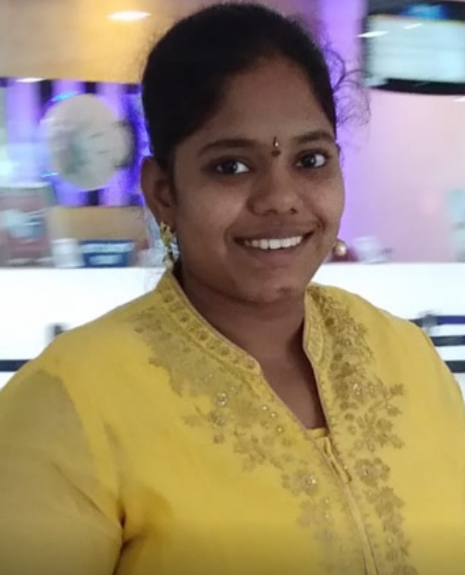
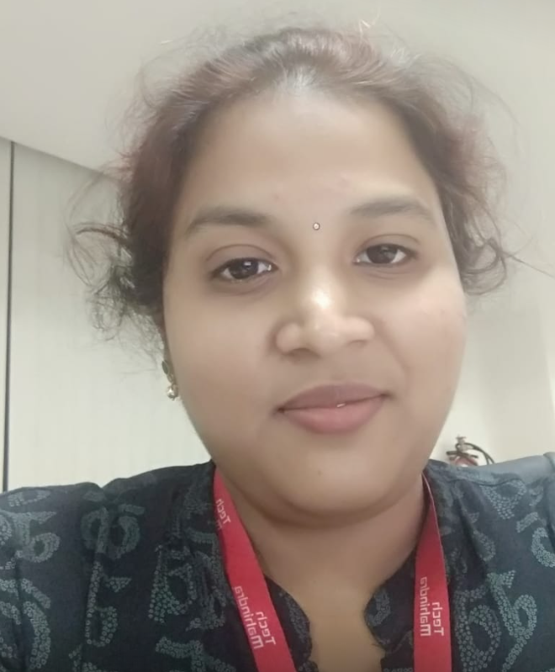

THE TEAM – Thank you
Nizam
Srinivas
Vikram
Lead System Architect
Senior System Architect
Senior System Architect
Madhuri
Aparna
Mounika
System Architect
System Architect
System Architect

